Slide 1
HOW TO DO BUSINESS WITH THE CITY OF PALM BEACH GARDENS

Slide 2

“How to Do Business with the City of Palm Beach Gardens”
INFO ON THE PROCUREMENT MANAGEMENT OFFICE
WHO ARE WE?
WHAT DO WE DO?
Km! Ra, CPSM, C.P.M., CPPO, CPPB, CAP-OM, CPCP, FCCM
Chief Procurement Officer
Purchase Orders
Purchasing and Contracts Management.
Purchasing Card Program.
Grants Research and Administration.
561.799.4197
kmra@pbgfl.gov

Slide 3

“How to Do Business with the City of Palm Beach Gardens”
AGENDA
How to Access the Purchasing Webpage on the City’s website.
Purchasing Thresholds.
SBE/DBE and Local Preferences
Solicitation Types: A) Request for Proposals; B) Invitation to Bid; C) Invitation to Quote; Request for Qualifications; and D) Request for Letters of Interest.
Responsiveness Determination.
Responsibility Determination.
How Contracts are Awarded.
Cone of Silence.
Purchasing Card Program.
Vendor Non-Performance and Vendor Termination.
Ethics and Expected Standards of Conduct.
Questions.

Slide 4
“How to Do Business with the City of Palm Beach Gardens”
THE INFORMATION HIGHWAY
The City’s website is located at -www.pbgfl.gov.
The Procurement Management’s webpage can be directly accessed at -www.pbgfl.gov/procurement.

Slide 5

“How to Do Business with the City of Palm Beach Gardens”
PURCHASING THRESHOLDS
Below $25,000: no quotations required.
$25,000 - $65,000: requires at least 3 quotations.
Above $65,000: requires at least 3 formal written quotations.
Generally, purchases over $65,000 require a formal solicitation.
Contracts that exceed the City Manager’s authority must be authorized by the City Council. The City Manager can sign contracts that do not exceed 0.25% of the approved Budget.
Purchasing Cards: individual limits for immediate purchases and/or deliveries is normally $25,000.

Slide 6
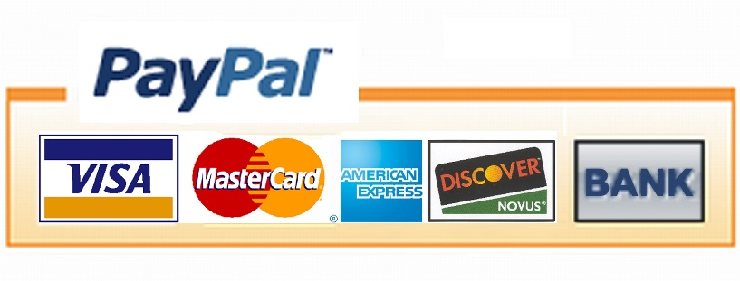
“How to Do Business with the City of Palm Beach Gardens”
VENDOR PAYMENT METHODS
The City does a “check-run” every 2 weeks.
All our contracts follow Florida Statutes: 30 days for SBEs and 45 days for all others.
However, usually payments are made within 15 days for most vendors unless there are issues with the invoice.
City prefers to pay through ACH (direct deposit) because it is much quicker. Any vendor can sign up for this process (it is free).
Currently working with our banks to develop more efficient and faster electronic payment methods.

Slide 7
“How to Do Business with the City of Palm Beach Gardens””
SBE/DBE AND LOCAL PREFERENCE
Currently, the City DOES NOT have any established Small Business Enterprise, Disadvantaged Business Enterprise, or Local Preferences.
However, such requirements may be part of individual solicitations based on the funding sources or at the request of City Council or City Manager.

Slide 8

“How to Do Business with the City of Palm Beach Gardens”
REQUEST FOR PROPOSALS
The City uses RFPs to primarily purchase professional services, and construction projects.
Examples are property insurance, auditing, design-build construction, health benefits, engineering projects, etc.

Slide 9
“How to Do Business with the City of Palm Beach Gardens”
INVITATION TO BID
ITBs are used to purchase goods and services when the City can describe very clearly what it wants and the estimated quantities.

Slide 10

“How to Do Business with the City of Palm Beach Gardens”
INVITATION TO QUOTE
ITQs are used to purchase goods and services when the City can describe very clearly what it wants and the estimated quantities. They are usually used for standard low dollar-value standard items where the total amount is $65,000 or less.

Slide 11

“How to Do Business with the City of Palm Beach Gardens”
REQUEST FOR LETTERS OF INTEREST
RLIs are used to purchase services when the City cannot describe very clearly what it wants, and will allow vendors to suggest solutions. Currently, RLIs are primarily used for the City’s recreation programs like baseball, soccer, yoga, art, theatre, etc.

Slide 12

“How to Do Business with the City of Palm Beach Gardens”
REQUEST FOR QUALIFICATIONS
RFQs are used to purchase certain professional services that the law (Florida Statutes) requires the vendor be selected based only on their qualifications or experience, and that no pricing information is submitted or considered during selection. Examples are engineering services, architects, etc.

Slide 13

“How to Do Business with the City of Palm Beach Gardens”
WHERE TO FIND CITY BIDS
City Solicitations (Bids) are posted and made available through the following resources:
OpenGov (e-procurement provider)
City’s website (Procurement Management webpage)

Slide 14

“How to Do Business with the City of Palm Beach Gardens”
WHO IS A “RESPONSIVE” BIDDER?
A RESPONSIVE BIDDER OR PROPOSER IS:
a Bidder or Proposer whose Bid or Proposal conforms in all material respects to the terms and conditions included in the Invitation to Bid or Request for Proposals.

Slide 15
“How to Do Business with the City of Palm Beach Gardens”
WHO IS A “RESPONSIBLE” BIDDER?
A RESPONSIBLE BIDDER OR PROPOSER IS:
a Bidder or Proposer who has the capability, in all respects, to perform in full the contract requirements, as stated in the Invitation to Bid or Request for Proposals, and the integrity and reliability that will assure good-faith performance.

Slide 16

“How to Do Business with the City of Palm Beach Gardens”
HOW ARE CONTRACTS AWARDED?
The City award contracts to the responsive and responsible vendor, based on the Method of Award in the Solicitation. The Methods of Award include:
Lowest price offered.
Highest discount.
Highest ranked vendor based on evaluation scores.
Most qualified based on evaluation criteria.

Slide 17
“How to Do Business with the City of Palm Beach Gardens”
CONE OF SILENCE
Pursuant to Section 2-355 of Palm Beach County Ordinance No. 2011-039, and the purchasing policies of the City of Palm Beach Gardens, all Solicitations, once advertised and until the appropriate authority has approved an award recommendation, are under the “Cone of Silence”. This limits and requires documentation of communications between potential vendors and/or bidders or proposers on City Solicitations, to the City’s professional staff, and City Council members.

Slide 18
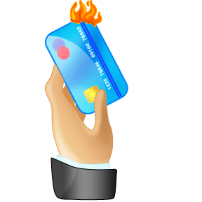
“How to Do Business with the City of Palm Beach Gardens”
PURCHASING CARD PROGRAM
Several members of the City’s staff have been assigned purchasing cards to allow them to make purchases on behalf of the City. There are restrictions on the use of the cards, and regular monthly and quarterly audits are conducted by the Procurement and Finance Departments.
The purchases are usually below the Small Purchases threshold of $25,000. Any p-card purchase above that threshold requires at least 3 quotes and prior approval from the Procurement Management Office.
City employees who have purchasing cards have been trained in the proper use of the purchasing card.
Misuse of the card can lead to employee termination and vendor debarment.

Slide 19

“How to Do Business with the City of Palm Beach Gardens”
NON-PERFORMANCE AND TERMINATION
Non-performance is noted and documented in writing. Vendors are usually allowed the opportunity to cure the non-performance unless the situation is egregious.
Vendors who are terminated from City contracts are placed on a list of terminated vendors, and the City will not do business with that vendor for at least 3 years.
Vendor performance on City contracts and their interaction with City staff are also considered when responsibility determinations are made on future projects.
The City will terminate vendors for non-performance, based on the provisions in the Contract and/or Agreement.

Slide 20
“How to Do Business with the City of Palm Beach Gardens”
ETHICS AND STANDARDS OF CONDUCT
The City has a strict NO GIFTS policy and a Vendor Code of Conduct. The Vendor Code of Conduct establishes an expected standard of behavior, and is available for review on the Procurement Management’s webpage.
Rude or unprofessional behavior by vendors or City staff is not tolerated. Please report all unacceptable behavior by City staff to the City Manager or the Procurement Management Office. Such incidents, although very rare, are taken very seriously by senior management.
It is the vendor's responsibility to provide evidence to refute any assumption of collusion in bid submission. The City will allow the vendor an opportunity to provide evidence of non-collusion in bidding
Honesty is always the best policy when doing business with the City of Palm Beach Gardens.

