Slide 1

Purchasing Department 2023 Vendor Workshop

Slide 2

2023 Vendor Workshop How to Respond to Bids and Other Solicitations March 24, 2023
WELCOME!

Slide 3

2023 Vendor Workshop How to Respond to Bids and Other Solicitations
Event Host: City of Palm Beach Gardens
Km! Ra
CPSM, C.P.M., CPPO, CPPB, CAP, OM; CPCP, FCCM, PMP
Purchasing and Contracts Director
Office: (561) 799-4197 | Site: www.pbgfl.com
Address: 10500 N. Military Trail | Palm Beach Gardens, FL 33410

Slide 4
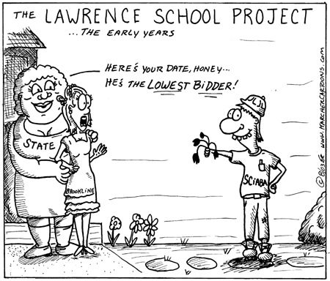
2018 Vendor Workshop How to Respond to Bids and Other Solicitations

Slide 5

2023 Vendor Workshop How to Respond to Bids and Other Solicitations

Slide 6

2023 Vendor Workshop How to Respond to Bids and Other Solicitations
Types of Solicitations
Invitation to Bid ITB
Request for Proposal RFP
Request for Qualification RFQ
Request for Letters of Interest RLI
Request for Information RFI
Invitation to Negotiate ITN
Invitation to Quote ITQ
Construction Manager @ Risk CMAR
This Photo by Unknown Author is licensed under CC BY-NC-ND

Slide 7
2023 Vendor Workshop How to Respond to Bids and Other Solicitations
Typical Sections
Instructions/Contact Person
Table of Contents
Special Terms and Conditions
Statement of Work
Submittals

Slide 8
2023 Vendor Workshop How to Respond to Bids and Other Solicitations
City eProcurement Portal
Mercell USA
All responses and addendums are through the e-procurement portal.

Slide 9
2023 Vendor Workshop How to Respond to Bids and Other Solicitations
Methods of Award
Lowest Price
Highest Price
Highest Discount
Highest Ranked (scored)
Best Value
Proximity (closest)

Slide 10
2023 Vendor Workshop How to Respond to Bids and Other Solicitations
Key Factors for Award
Invitation to Bid Price
Request for Proposal Score/Rank
Request for Qualification Score/Rank
Request for Letters of Interest Score/Rank
Request for Information Score/Rank
Invitation to Negotiate Price
Invitation to Quote Price

Slide 11

2023 Vendor Workshop How to Respond to Bids and Other Solicitations
What Not To Do
Exceptions
Changes
Too Much Fluff
Late Submission
Not Reading the Solicitation

Slide 12

2023 Vendor Workshop How to Respond to Bids and Other Solicitations
What To Do
Address the Evaluation Criteria
Signature
Timely Submission
READ THE INSTRUCTIONS!
Almost Everything is a Public Record

Slide 13
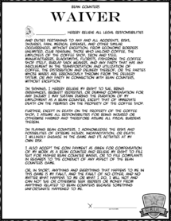
2023 Vendor Workshop How to Respond to Bids and Other Solicitations
What’s That…?
Bid Waiver: waives the competitive process
Sole Source: only vendor who sells the commodity
Single Source: standardization; justification/emergency
Do the Work Ourselves

Slide 14

2023 Vendor Workshop How to Respond to Bids and Other Solicitations
Where to Find Bids
Newspapers
City Websites
DemandStar
Mercell USA
Blue Book
Public Purchase
Entity Vendor List
Many Others – Go Look!

Slide 15

2023 Vendor Workshop How to Respond to Bids and Other Solicitations
Thank You!

